Slide 1


Enticing Clicks with Calls-to-Action

Slide 2
1
HOW DO YOU USE A CALL-TO-ACTION (CTA)?

Slide 3
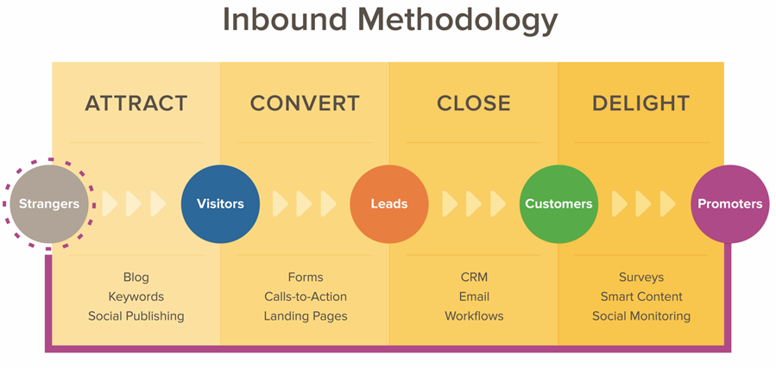

Slide 4
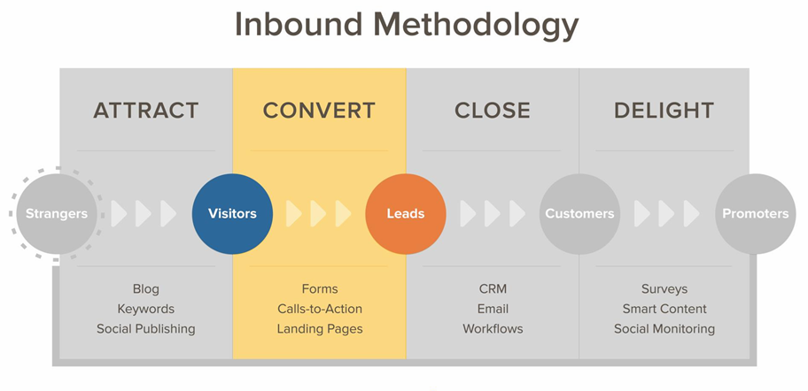

Slide 5
YOU CAN’T GET LEADS WITHOUT A CONVERSION PROCESS.

Slide 6
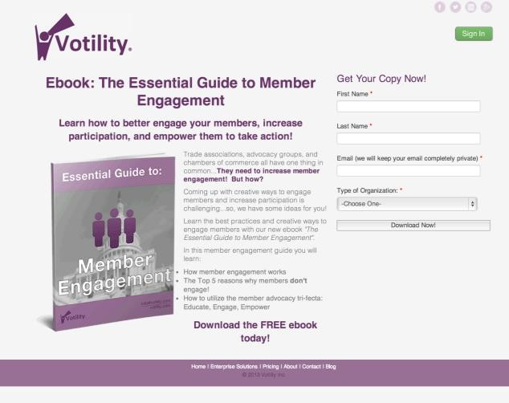
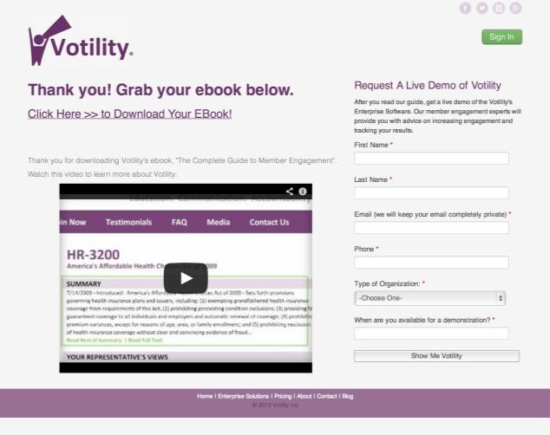


The Conversion Process
Call-to-Action
Landing Page
Thank You Page

Slide 7
WHAT IS A CTA?
A CTA is a button that promotes an offer and links to a landing page.

Slide 8
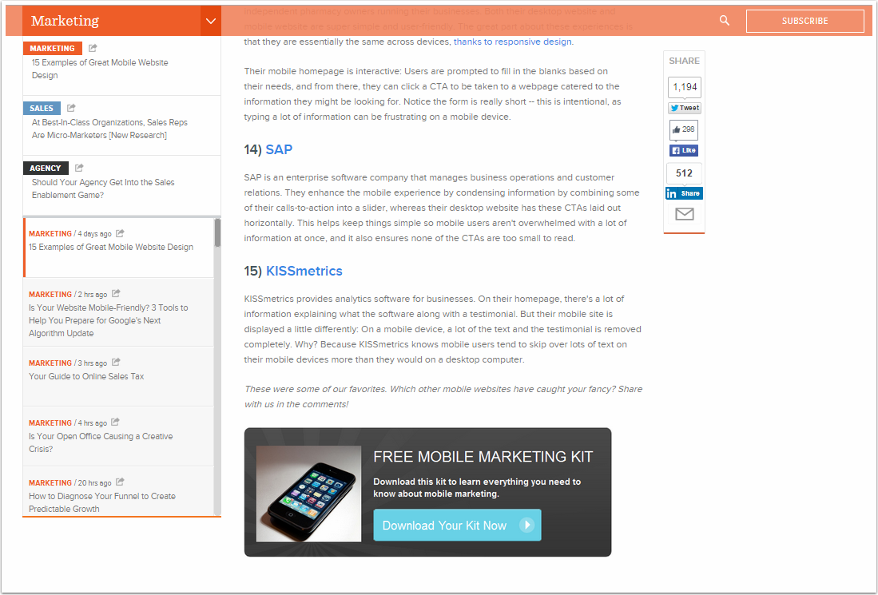
A CTA kicks off the conversion process.

Slide 9
The Conversion Process
Call-to-Action
Landing Page
Thank You Page

Slide 10
2
HOW DO YOU CREATE SUCCESSFUL CTA’S?

Slide 11
WHICH SEQUENCE MAKES UP A COMPLETE CONVERSION PROCESS?
Call-to-Action > Blog Post > Landing Page
Landing Page > Call-to-Action > Thank You Page
Blog Post > Call-to-Action > Landing Page
Call-to-Action > Landing Page > Thank You Page

Slide 12
WHICH SEQUENCE MAKES UP A COMPLETE CONVERSION PROCESS?
Call-to-Action > Blog Post > Landing Page
Landing Page > Call-to-Action > Thank You Page
Blog Post > Call-to-Action > Landing Page
Call-to-Action > Landing Page > Thank You Page

Slide 13
WHICH SEQUENCE MAKES UP A COMPLETE CONVERSION PROCESS?
Call-to-Action > Blog Post > Landing Page
Landing Page > Call-to-Action > Thank You Page
Blog Post > Call-to-Action > Landing Page
Call-to-Action > Landing Page > Thank You Page

Slide 14
WHICH SEQUENCE MAKES UP A COMPLETE CONVERSION PROCESS?
Call-to-Action > Blog Post > Landing Page
Landing Page > Call-to-Action > Thank You Page
Blog Post > Call-to-Action > Landing Page
Call-to-Action > Landing Page > Thank You Page

Slide 15

CALL-TO-ACTION BEST PRACTICES
Make it action-oriented.
Include keywords consistent with offer & landing page.
Make it attention-grabbing.
Use strong and appropriate on-page placement.
Test changes and analyze their results.

Slide 16
CALL-TO-ACTION BEST PRACTICES
Make it action-oriented.
Include keywords consistent with offer & landing page.
Make it attention-grabbing.
Use strong and appropriate on-page placement.
Test changes and analyze their results.

Slide 17


Make it action-oriented.
Don’t make your visitors think too hard about what they need to do next. Just tell them!
Download the free travelling Guide
Action-oriented verb

Slide 18
CALL-TO-ACTION BEST PRACTICES
Make it action-oriented.
Include keywords consistent with offer & landing page.
Make it attention-grabbing.
Use strong and appropriate on-page placement.
Test changes and analyze their results.

Slide 19

Includes keywords consistent with the offer and landing page.
Without keywords, would you know what this offer is about?
_{Download the Guide}

Slide 20

Includes keywords consistent with the offer and landing page.
Using the same keywords and phrasing for the entire conversion process helps your visitors understand what they are going to get.
Download the Adventure travelling Guide
Keywords

Slide 21
CALL-TO-ACTION BEST PRACTICES
Make it action-oriented.
Include keywords consistent with offer & landing page.
Make it attention-grabbing.
Use strong and appropriate on-page placement.
Test changes and analyze their results.

Slide 22


Your CTA needs to stand out,
so that visitors will know to click on it.

Slide 23
CALL-TO-ACTION BEST PRACTICES
Make it action-oriented.
Include keywords consistent with offer & landing page. Make it attention-grabbing.
Use strong and appropriate on-page placement.
Test changes and analyze their results.

Slide 24



Use strong and appropriate on-page placement.
CTAs should seem like they belong and are not forced onto the page.

Slide 25
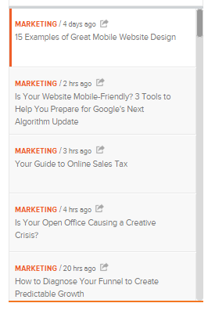


Place CTAs at the end of your blog posts.

Slide 26

Join our next live webinar!
CTAs in the sidebar should be general offers.
This way, they are applicable to the widest variety of people reading your blog.

Slide 27
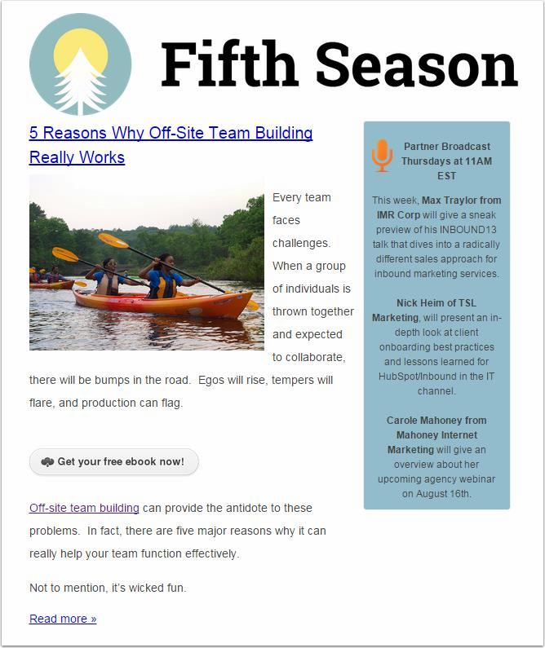
Place CTAs in emails.
CTAs can be placed at the end of the email, at the end of a paragraph, or sentence.

Slide 28
CALL-TO-ACTION BEST PRACTICES
Make it action-oriented.
Include keywords consistent with offer & landing page.
Make it attention-grabbing.
Use strong and appropriate on-page placement.
Test changes and analyze their results.

Slide 29
1-2%
CTA click-through rate goal.

Slide 30
10%
CTA clicks-to-submissions goal.

Slide 31


Make one small change
and see how it performs.
Download the Adventure Travelling Guide
Download the Adventure Travel Guide

Slide 32
CALL-TO-ACTION BEST PRACTICES
Make it action-oriented.
Include keywords consistent with offer & landing page.
Make it attention-grabbing.
Uses strong and appropriate on-page placement.
Test a change and analyze the results.

Slide 33
3
WHAT DOES AN EFFECTIVE-CTA LOOK LIKE?

Slide 34
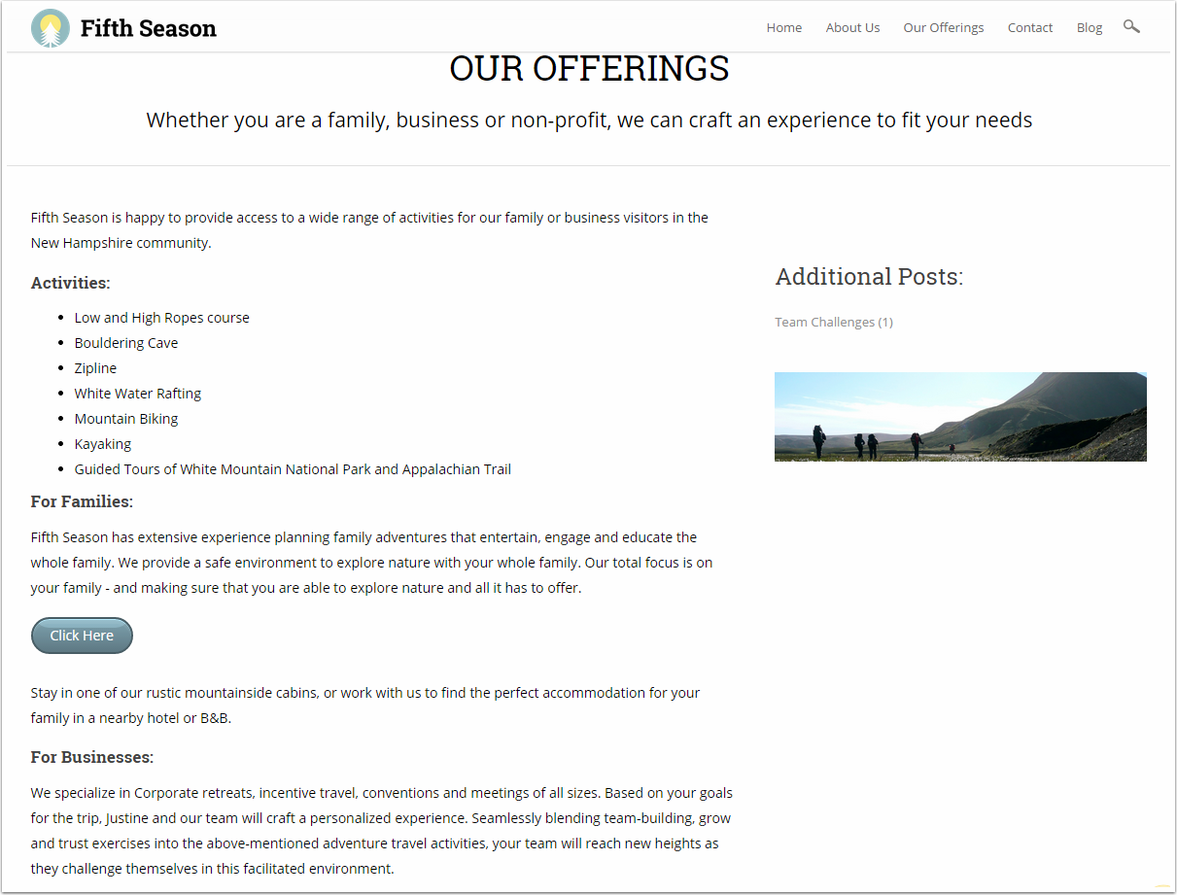


Slide 35
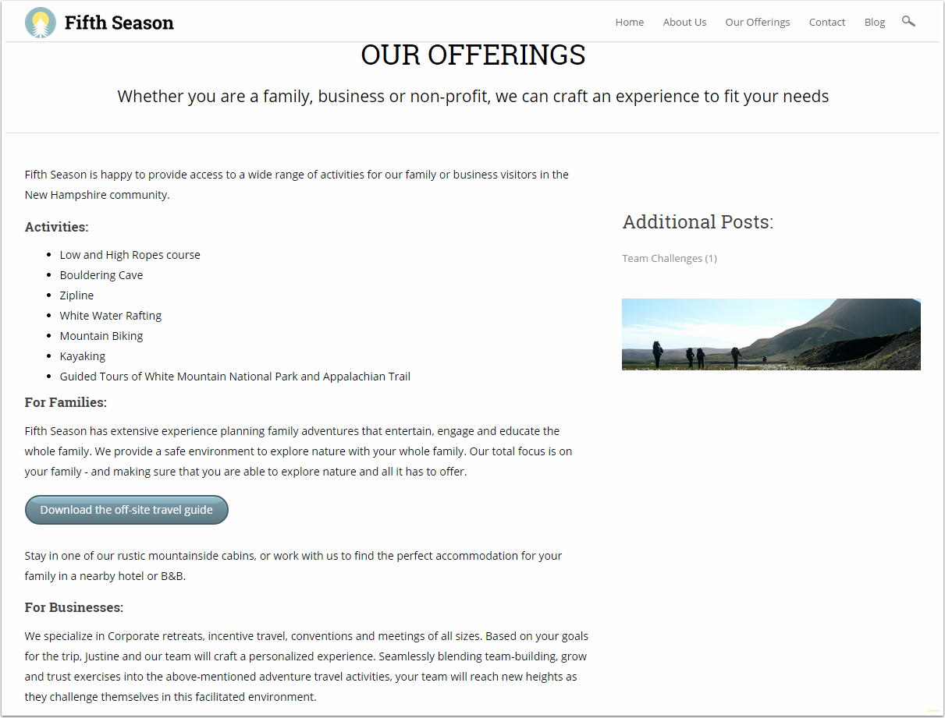

Slide 36
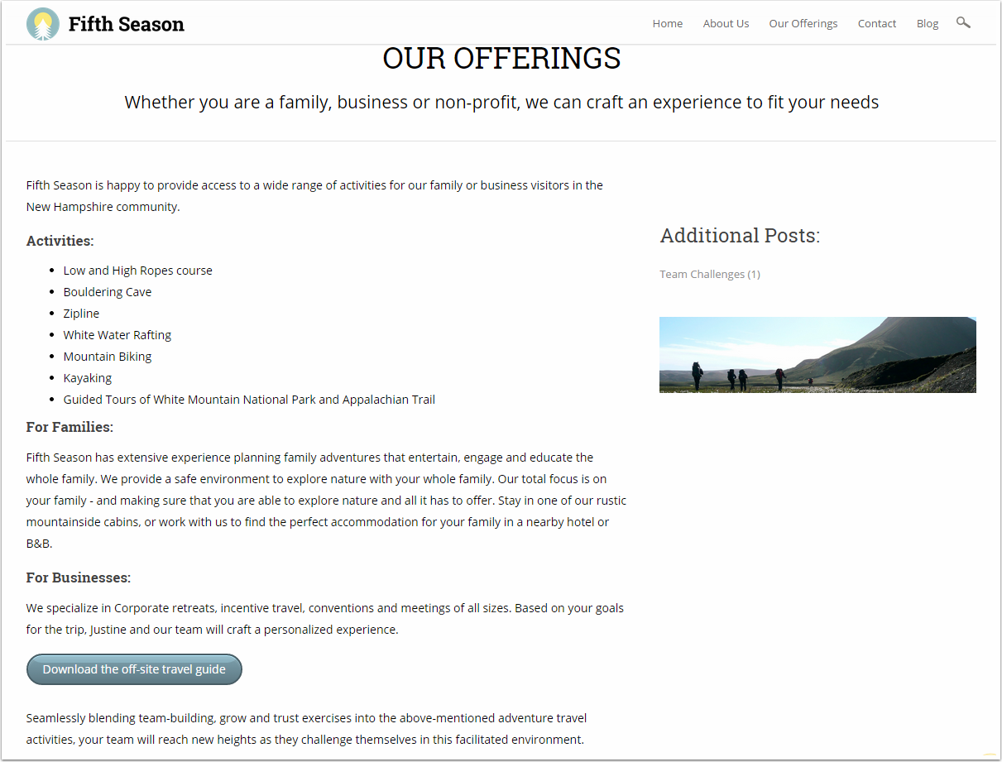

Slide 37
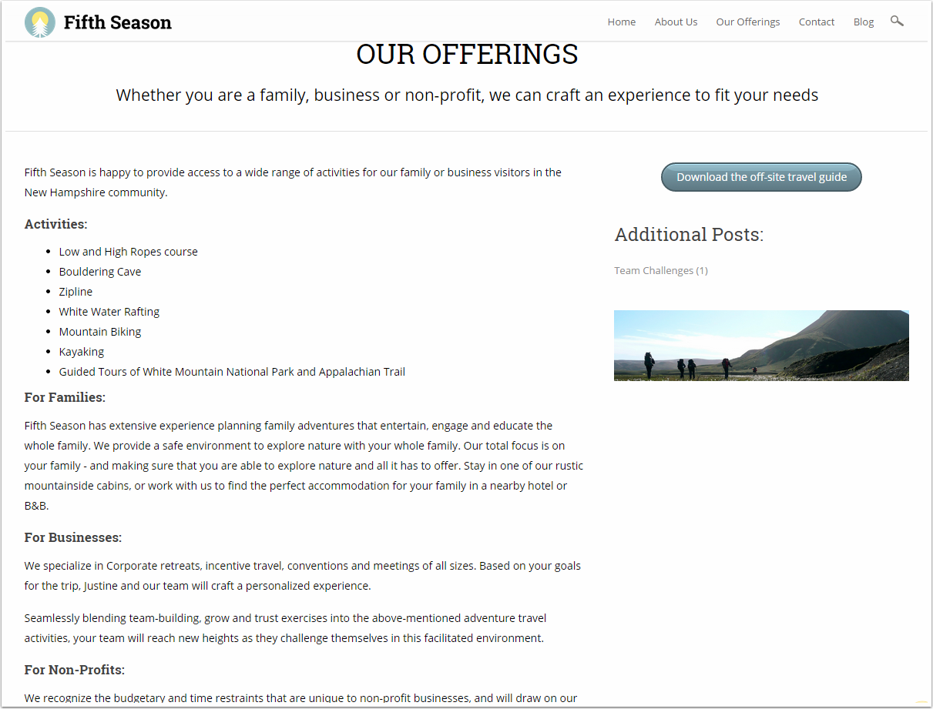

Slide 38
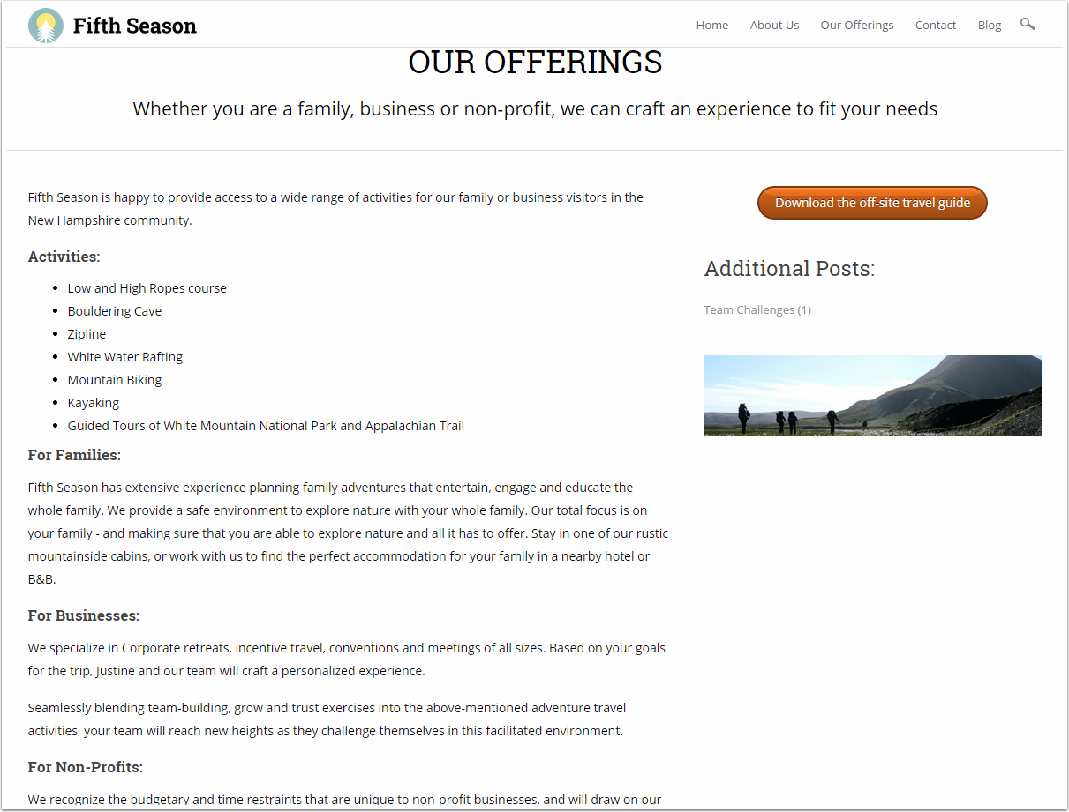

Slide 41
THANK YOU.

